Slide 1


Slide 2



Slide 3

eBay Online Shopping Store

Slide 4
eBay Online Shopping Store
Project Name :- eBay Online Shopping Store
Project Domain :- E-Commerce Domain
Project Tech. :- Manual Testing
Approach Followed :- Agile Methodology
Tools Used :- Selenium WebDriver , Jira , Google Sheet
Team Size :- 6 Members
Guided By :- Mr. Prasad Deshpande Sir

Slide 5

Individual Model Allocation
Obaidullah Khateeb :- Registration & Log Out Module
Mujahid Shaikh :- Login Module
Faiz Ahmad Tadkal :- Profile Edit Module
Faisal Mangalgiri :- Product Booking
Shuaib Tamboli :- Product Purchasing
Mushraf Ali Mucchale :- Message Searching

Slide 6
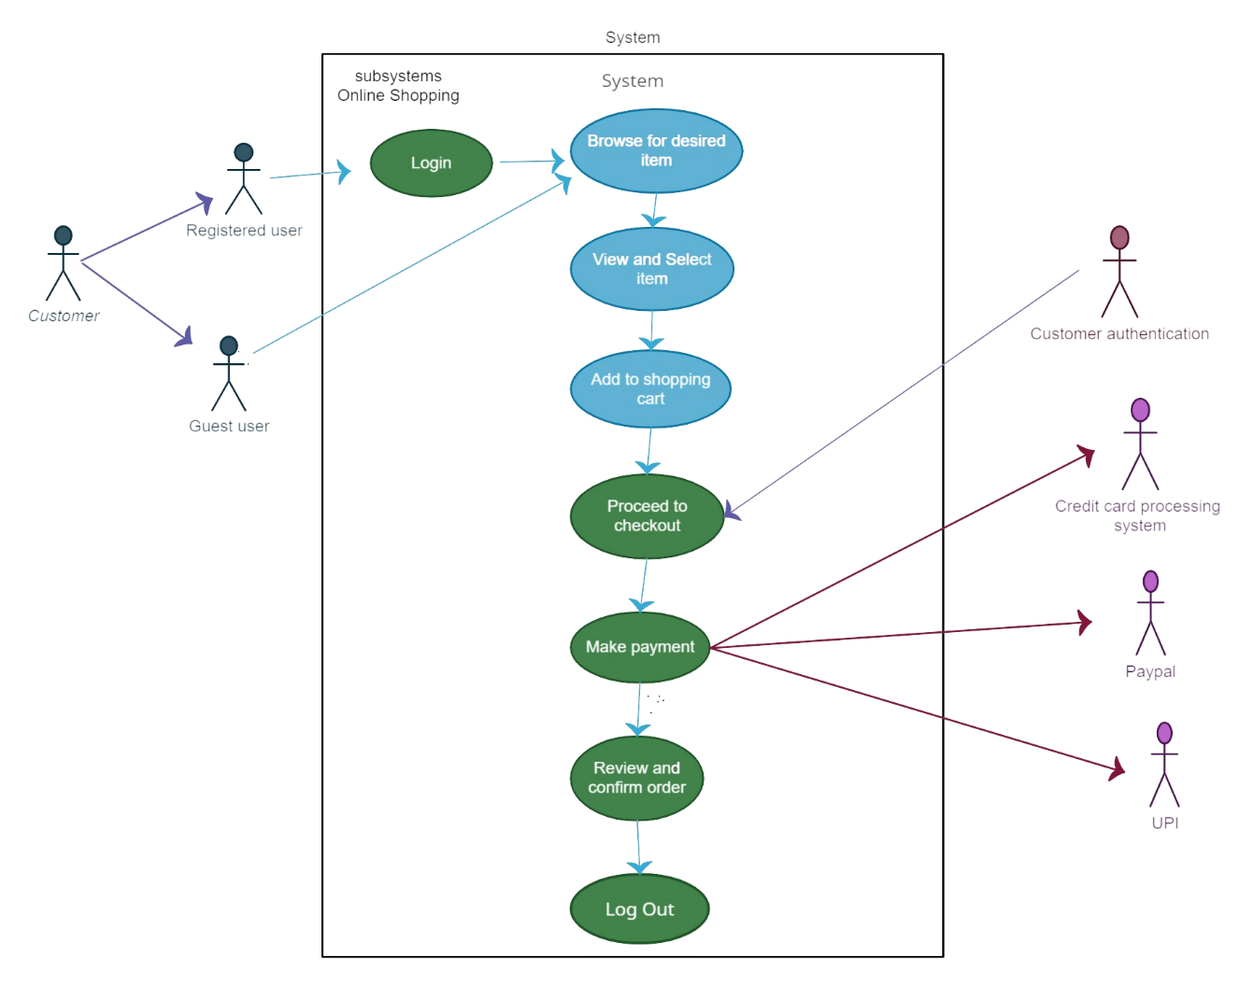
Use Case Diagram

Slide 7
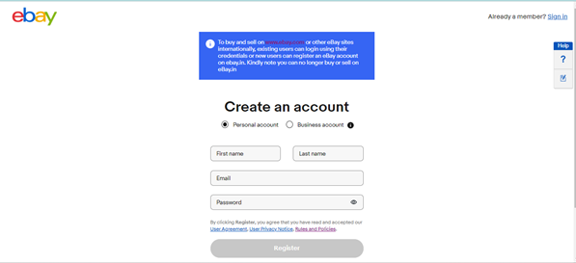
Personal Registration
Allocated to :- Obaidullah Khateeb
User Can Register By Filing Personal Information .

Slide 8
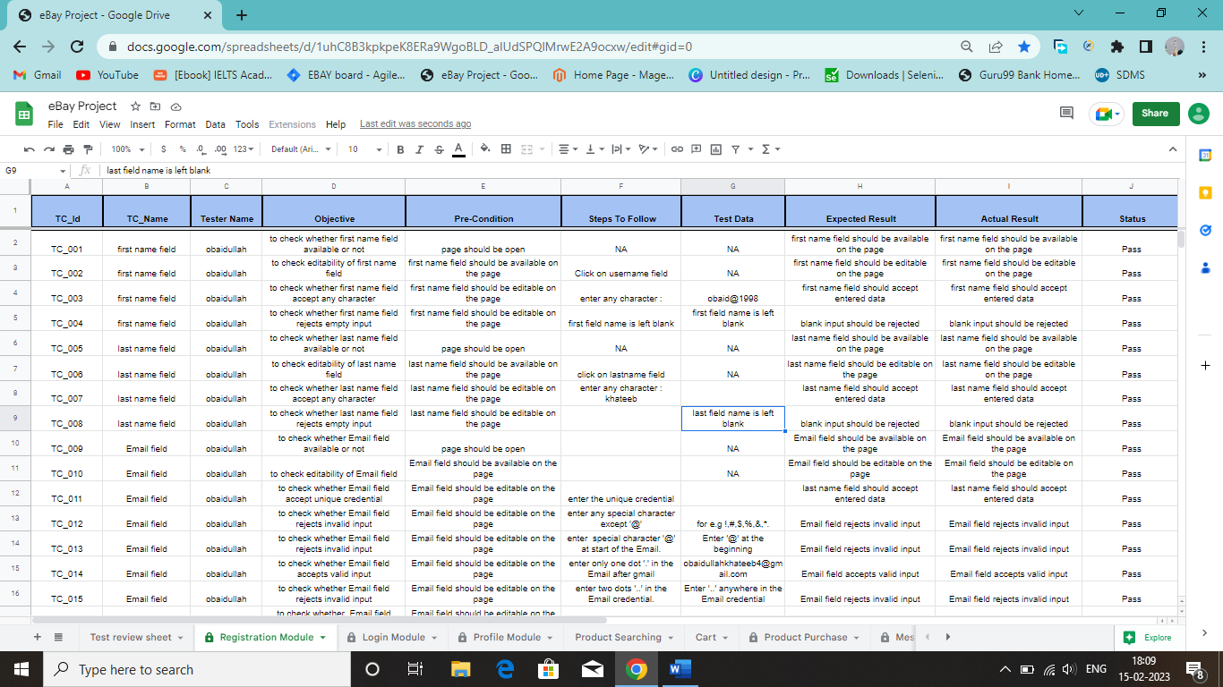
Test Cases For Registration

Slide 9
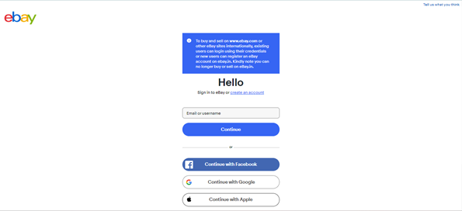
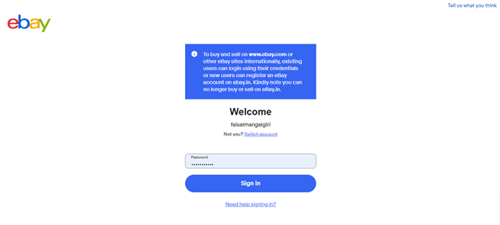
Login Module
Password Page
User Name Page
Allocated To :- Mujahid Shaikh
Only Registered Users Are Allowed To Login By Entering Correct Credentials .
If Wrong Credentials Are Entered Then Access Is Denied .
If User Forgets Password Then Forget Password Option Is Available .

Slide 10
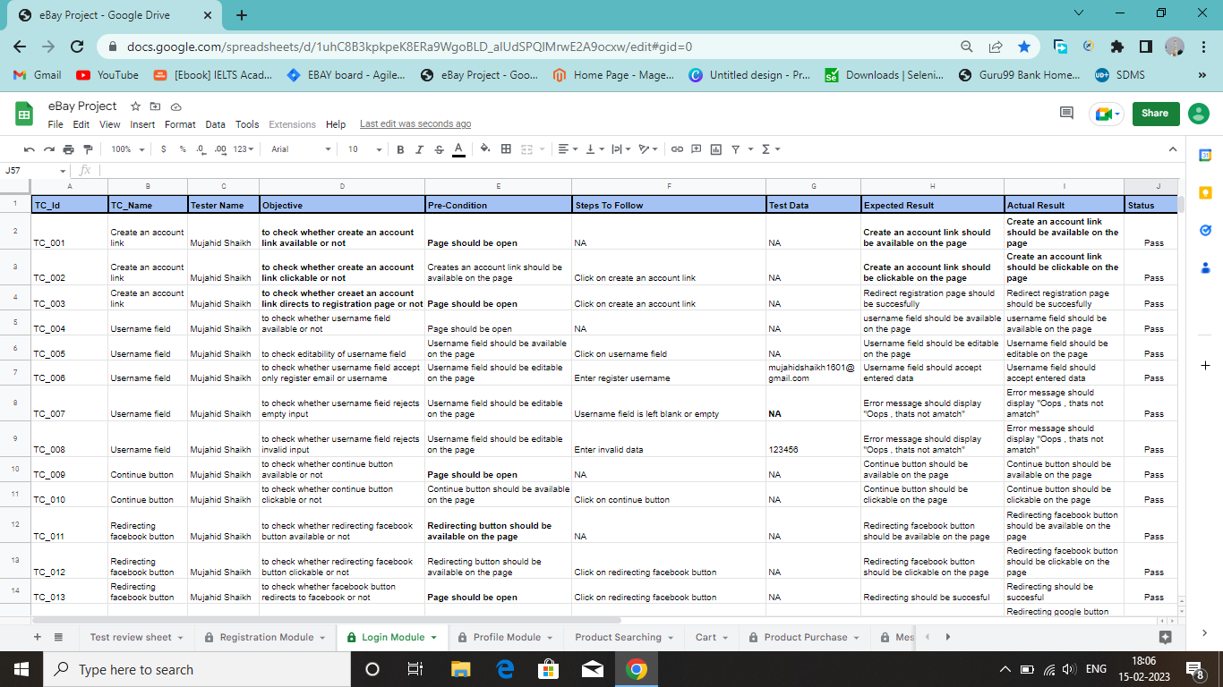
Test Cases For Login

Slide 11
Need Of Automation
1. Increase in test coverage: More scripts can be tested at the same time, resulting in an increase in the test coverage and reduces load of manual testers.
2. Greater accuracy: Continuous testing increases chances of errors while done manually, but in automated testing, repetitive testing reduces errors .
3. Cost saving: Despite high initial costs, once the automated framework is set up, there is an overall reduction in the costs.
4. Reduces testing time: Automated testing with testing tools allows manual testers to be freed from running repeated test cases . The testers get time to perform value-add tasks.
5. Performs tasks that cannot be done by manual testers: Certain test cases can be tested with automated testing, but cannot be performed by manual testers.
6. Time-saving: With automated testing, manual scripts are also automated and testing time is reduced. We can run test cases 24/7, by automating them that saves time .

Slide 12
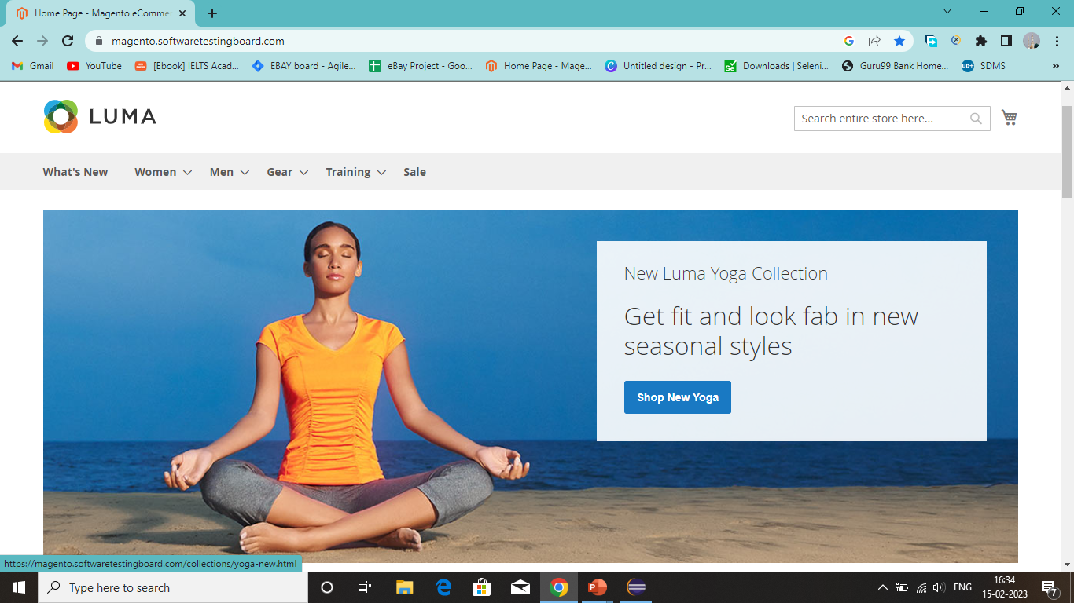
Home Page Of Luma (E-Commerce Site)

Slide 13
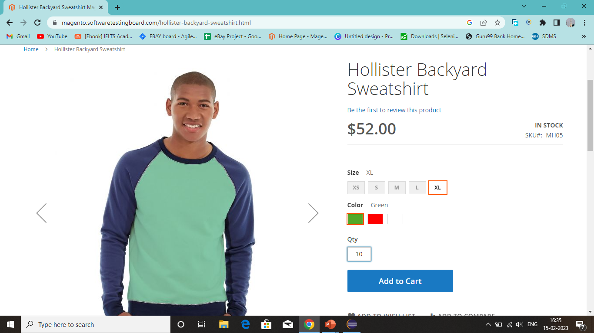
Product For Booking

Slide 14
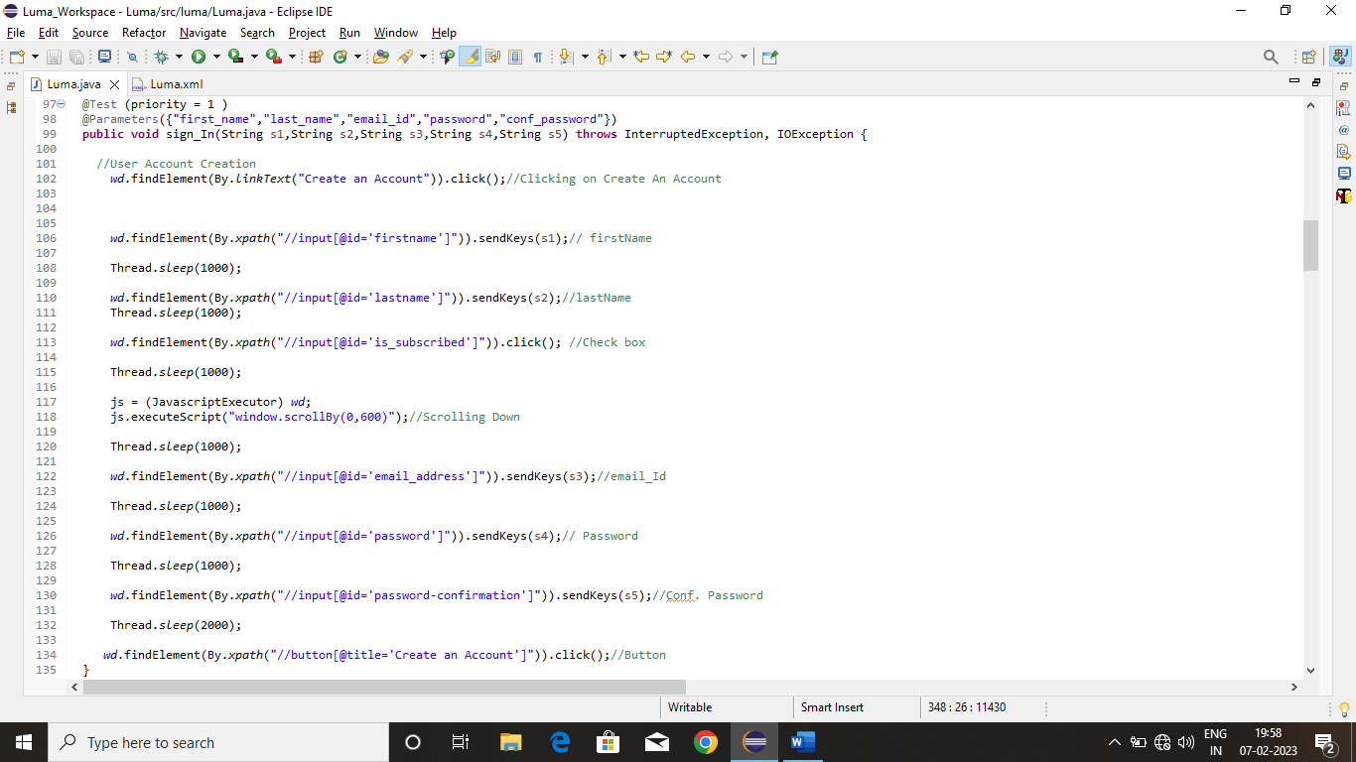
Code For Registration Page

Slide 15
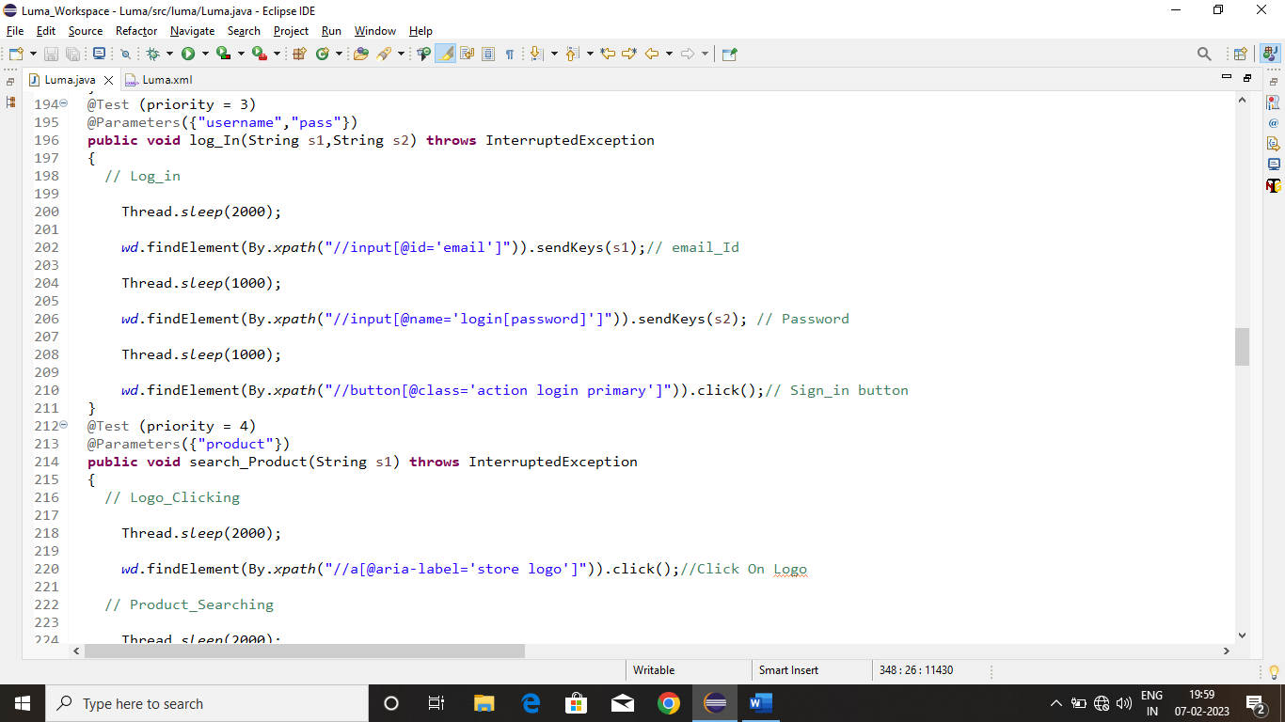
Code For Login Page

Slide 16
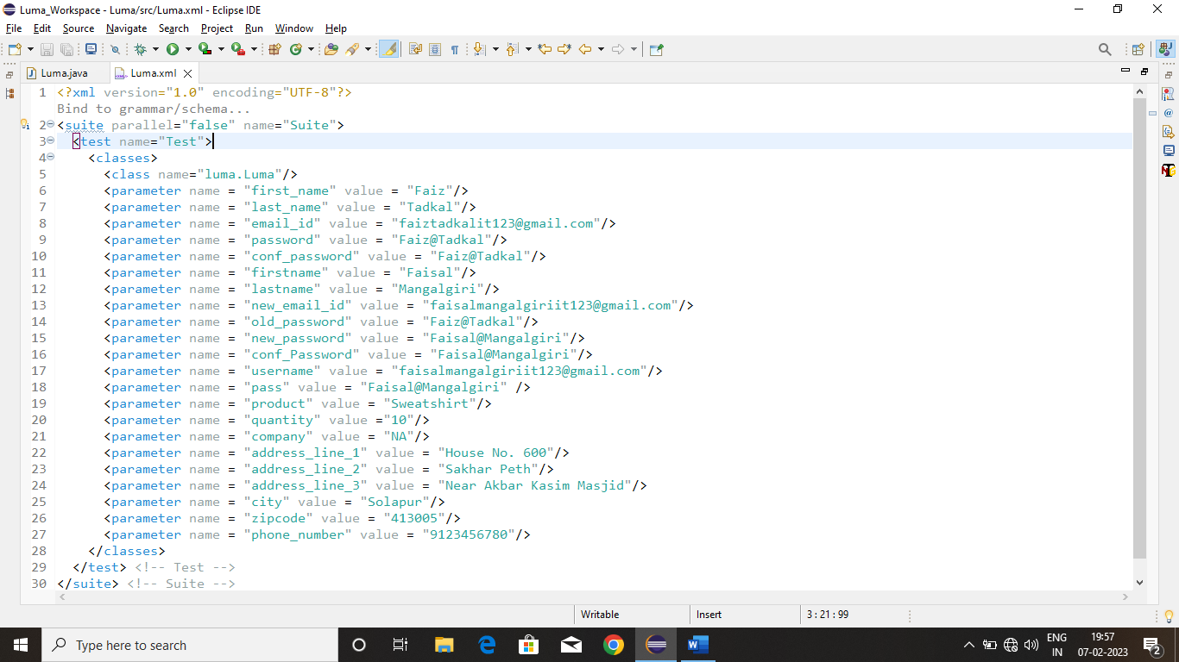
Xml Code

Slide 17
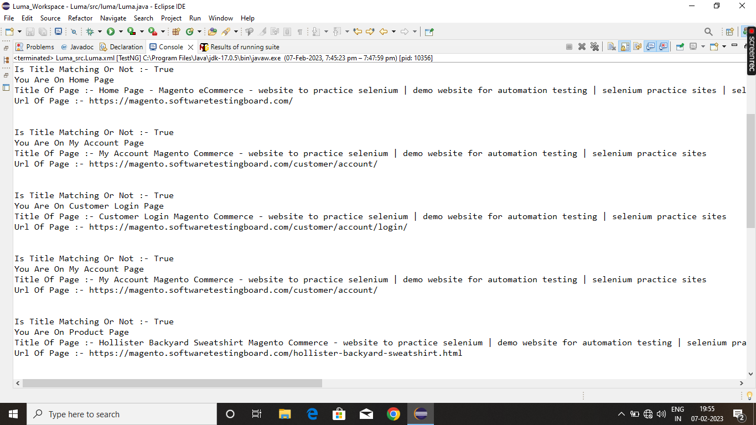
Output In Console

Slide 18
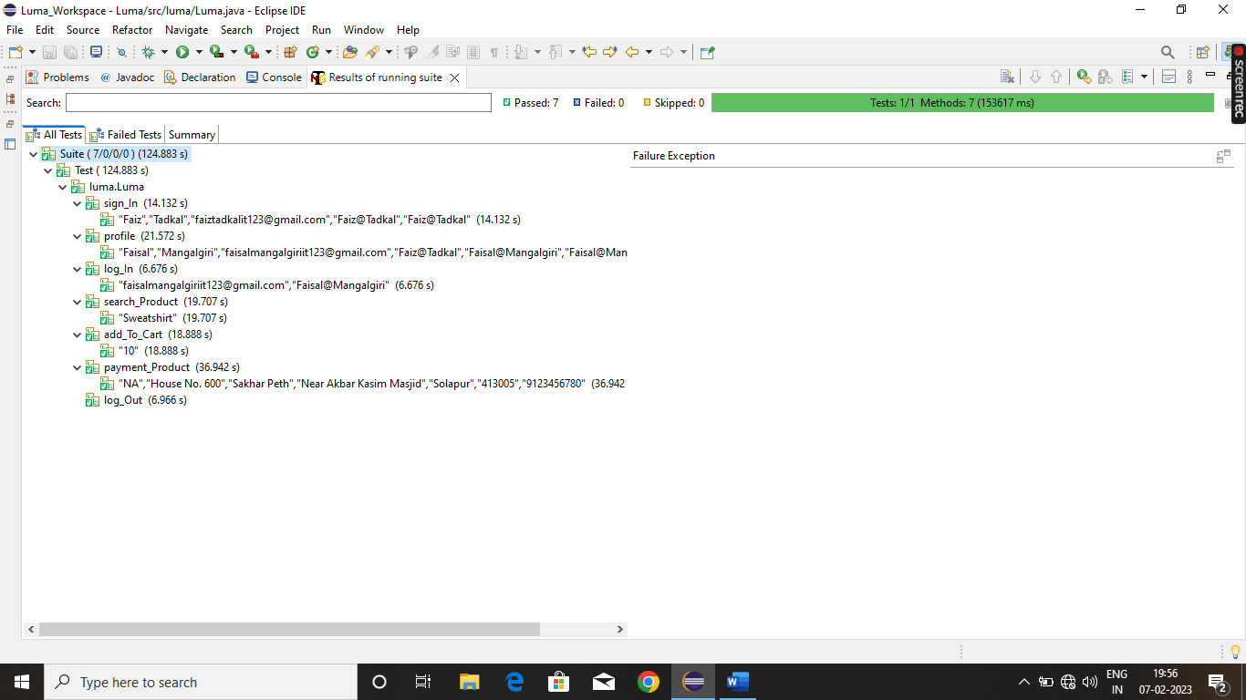
Result In TestNG

Slide 19
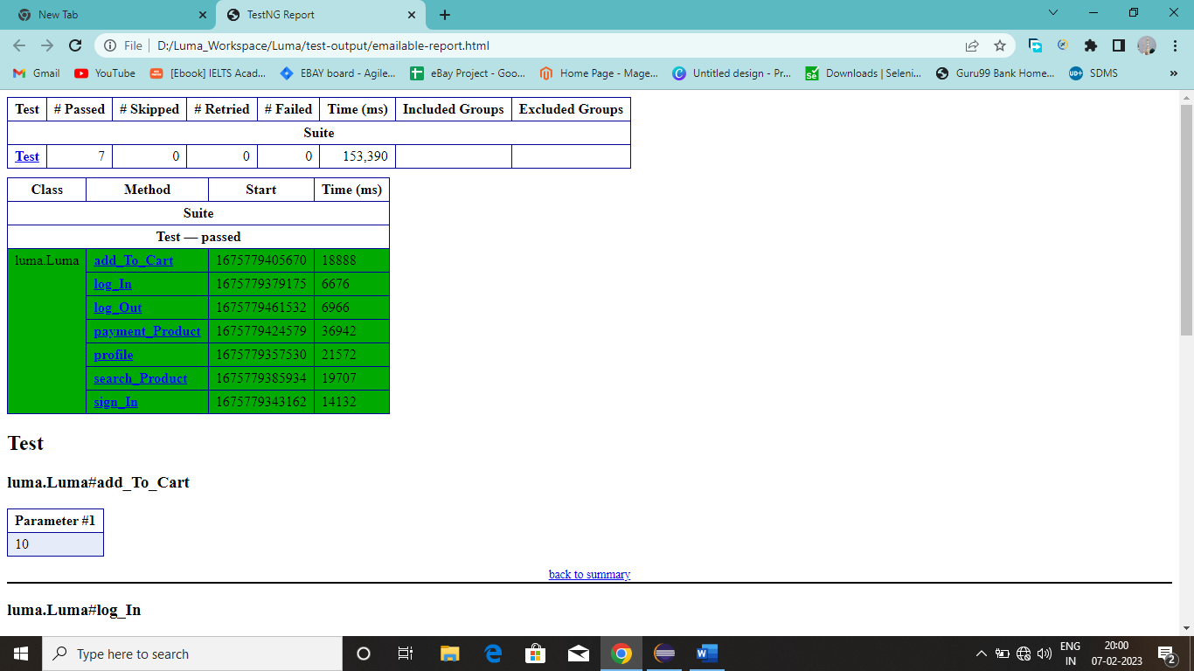
TestNG Report 1

Slide 20
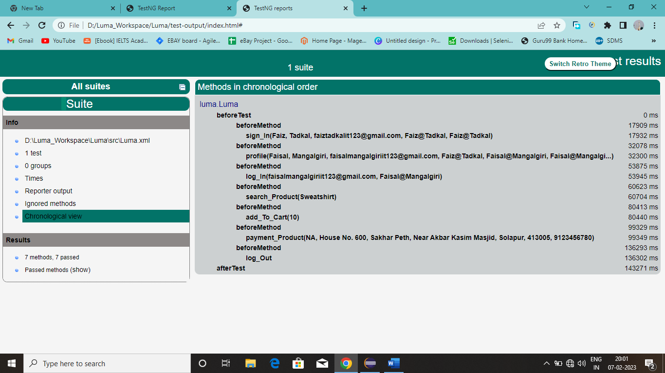
TestNG Report 2

Slide 21
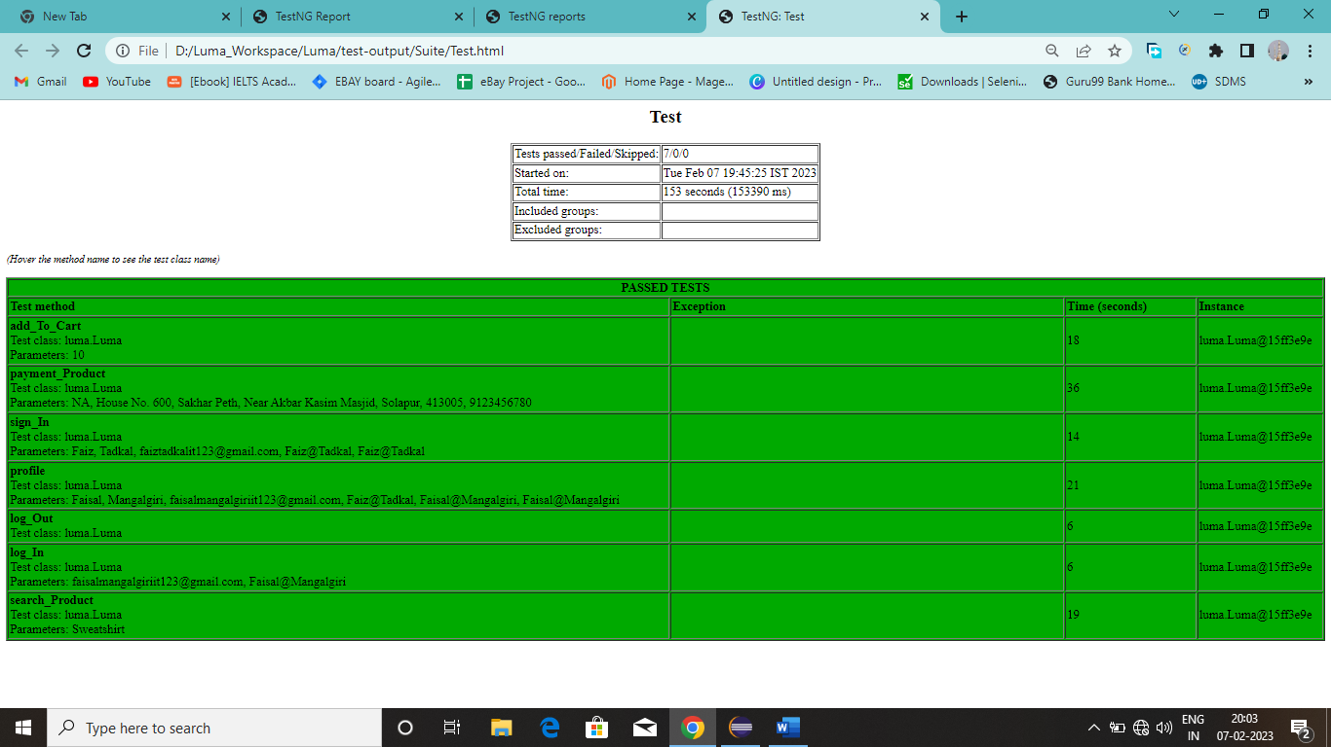
TestNG Report 3

Slide 22
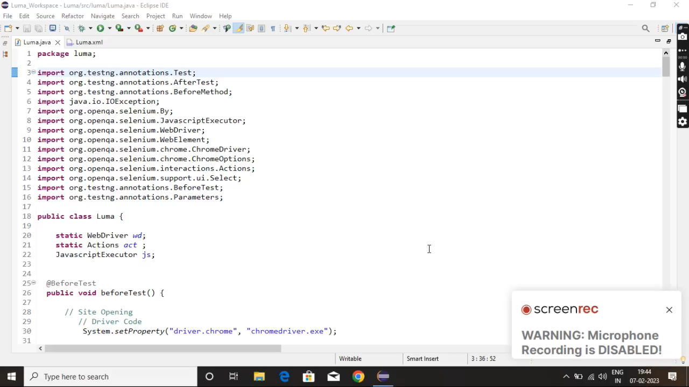
Video For Luma

Slide 23
Links For Reports
Index.html Link :- D:/Luma_Workspace/Luma/test-output/index.html
Emailable-report.html Link :- D:/Luma_Workspace/Luma/test-output/emailable-report.html
Text.html Link :- D:/Luma_Workspace/Luma/test-output/Suite/Test.html

Slide 24


